Slide 1

M. M. Engineering College, Mullana, Ambala Maharishi Markandeshwar (Deemed to be University),
Mullana, Ambala, Haryana, India
A Project Report Submitted in Fulfillment of the Requirements for the Award of Degree Of Bachelor of Technology In Computer Science and Engineering
BY
Harneet Kumar (11172662)
Ankit Kr. Jha (11172603)
*All are from Section B-1

Slide 2

Content
Project title
Introduction about Project objective of project work Platform Requirement Functionalities of project Project Screenshots

Slide 3

Computer Science Portal.
The ultimate resource to prepare for coding interviews. Everything you need, in one streamlined platform

Slide 4
Introduction
CSP is an interview prep platform for software engineers.
It's specifically geared towards those who want to work at a FAANG-level company.
Featuring a robust interactive coding preparation environment.
The ultimate resource to prepare for coding interviews. Everything you need, in one streamlined platform.

Slide 5
Objective/Aim:
CSP provides links to Computer Science learning resources that have been developed by the various Computer Science content development projects. The main content development project is the School of Computer Science.
This portal features exciting examples of Computer Science learning resources. CSP participants who are interested in Computer Science are invited to create and participate in learning projects and learning resources and help organize them by developing this portal.
We're just starting, but we already have some good materials.
The Computer Science Portal serves to provide quick access to everything in the Computer Science category.

Slide 6
Platform Requirement
Software Requirements: -
Operating System:
Ubuntu window
Front-End: HTML, CSS, JAVASCRIPT ,React
•
Hardware Requirements:-
Intel i5 (Processor).
8 GB Ram
512 KB Cache Memory

Slide 7

Functionalities of project
Easy to use
.well-defined navigation
.Easy-to-understand web design and clear user experience.
Quality product visuals and descriptions Distinct CTAs
Consistent company blog

Slide 8
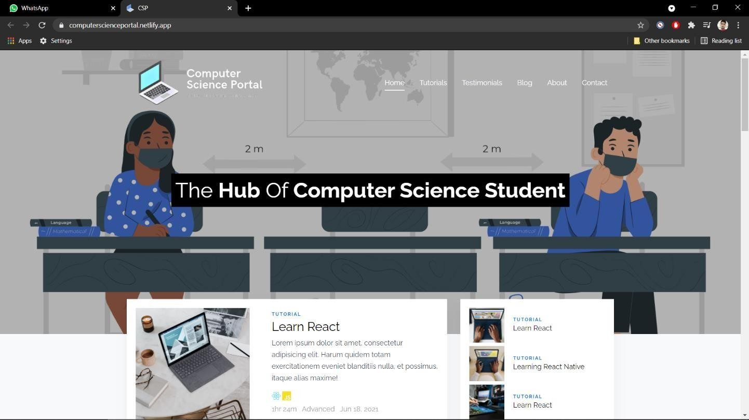
Screen shots obtained by running project
1.homepage

Slide 9
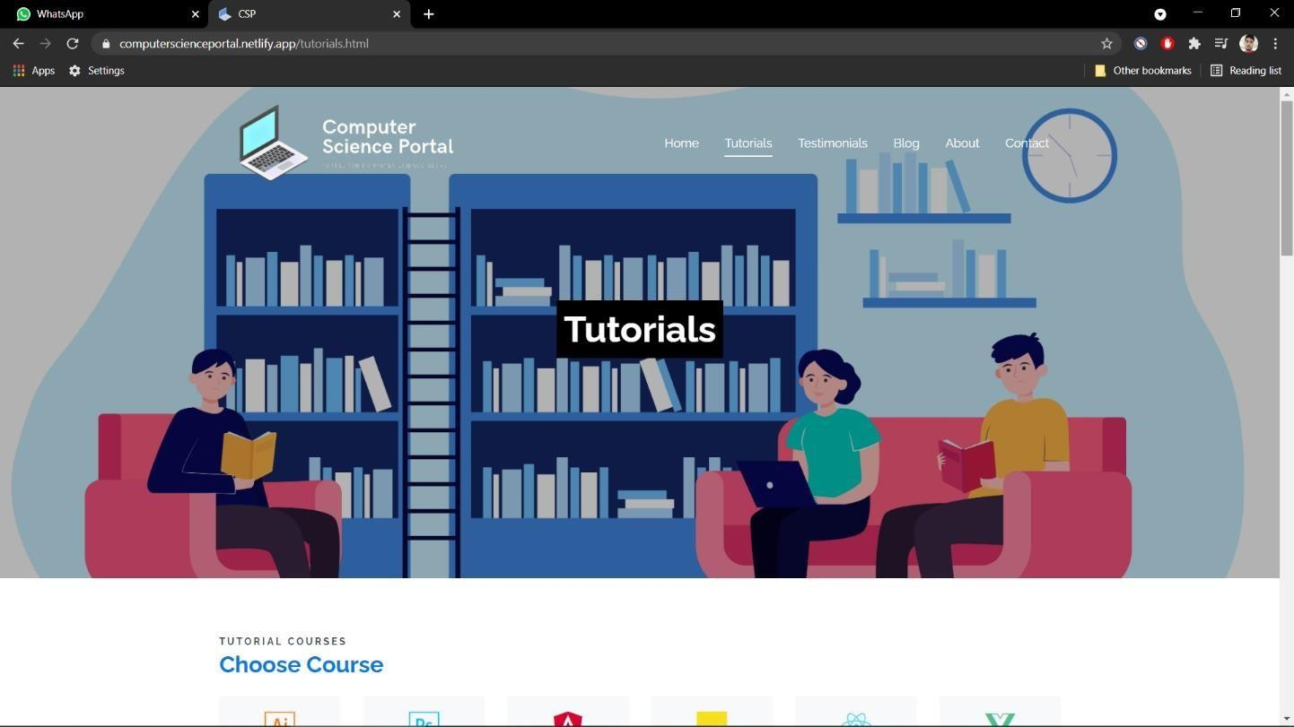
2.Tutorials Section

Slide 10
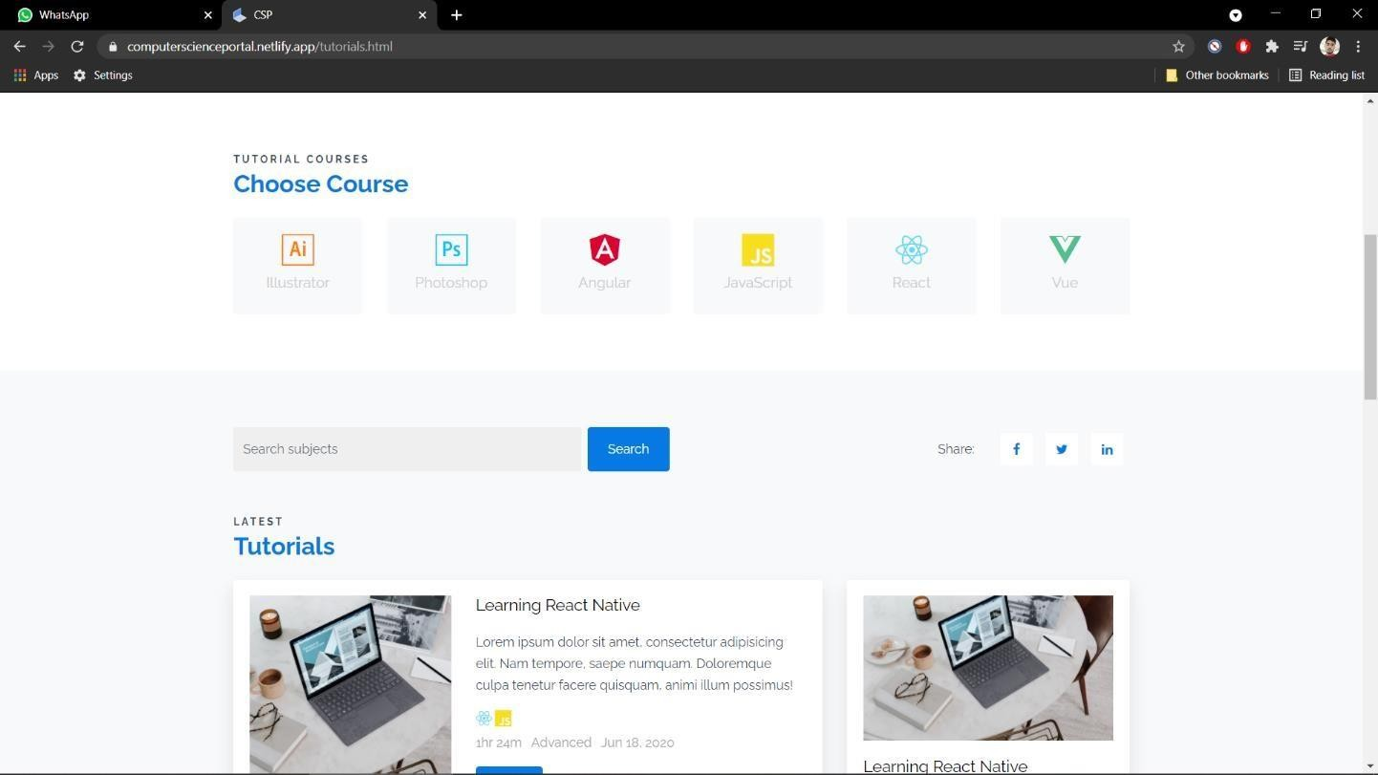
3.Choose Course-:

Slide 11
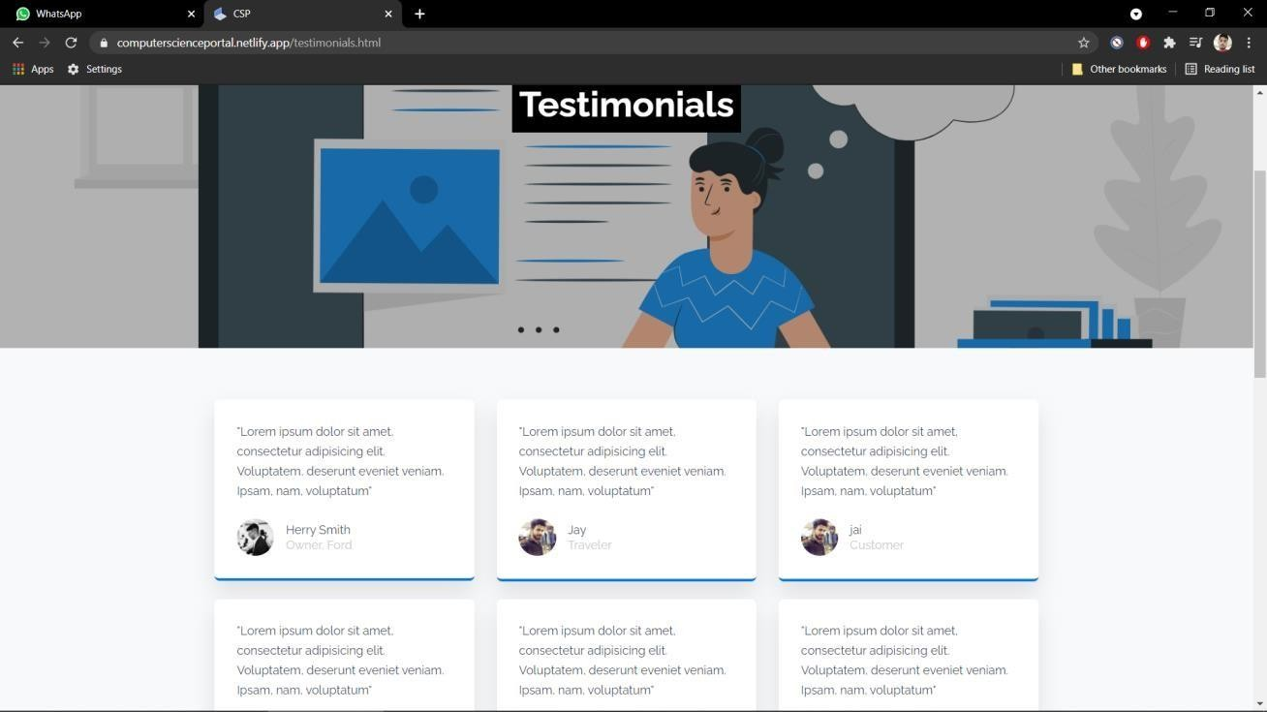
4.Testimonials-:

Slide 12
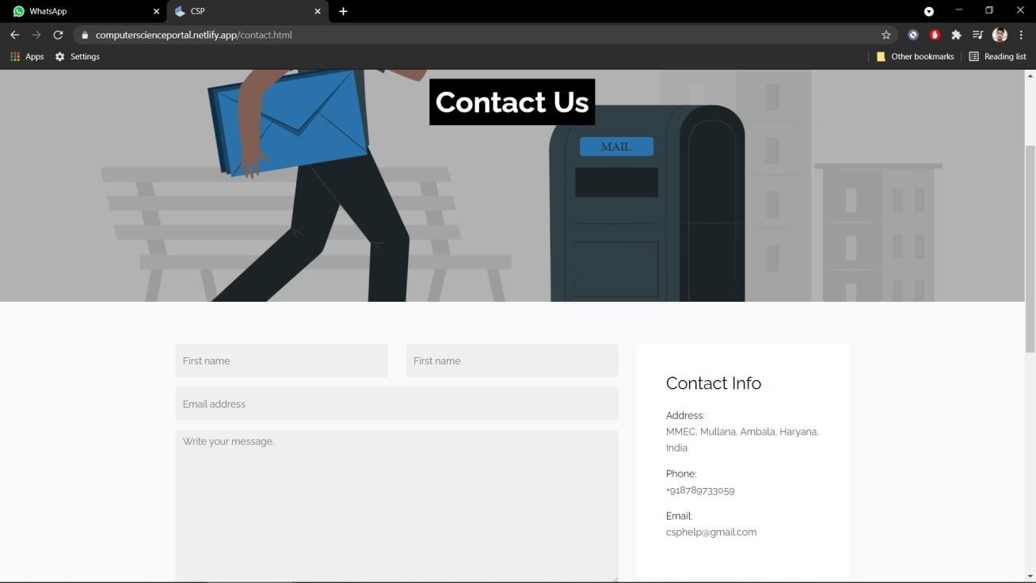
5.Contact
5) c c
o

Slide 13
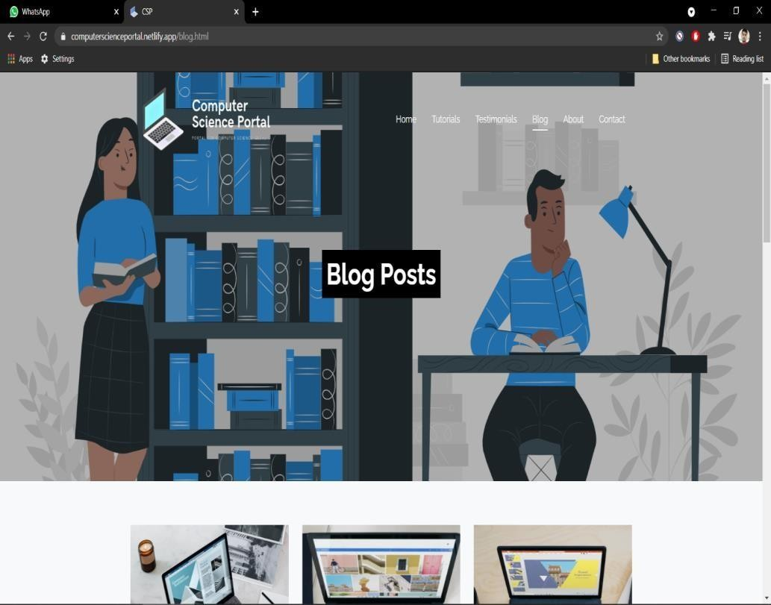

Slide 14
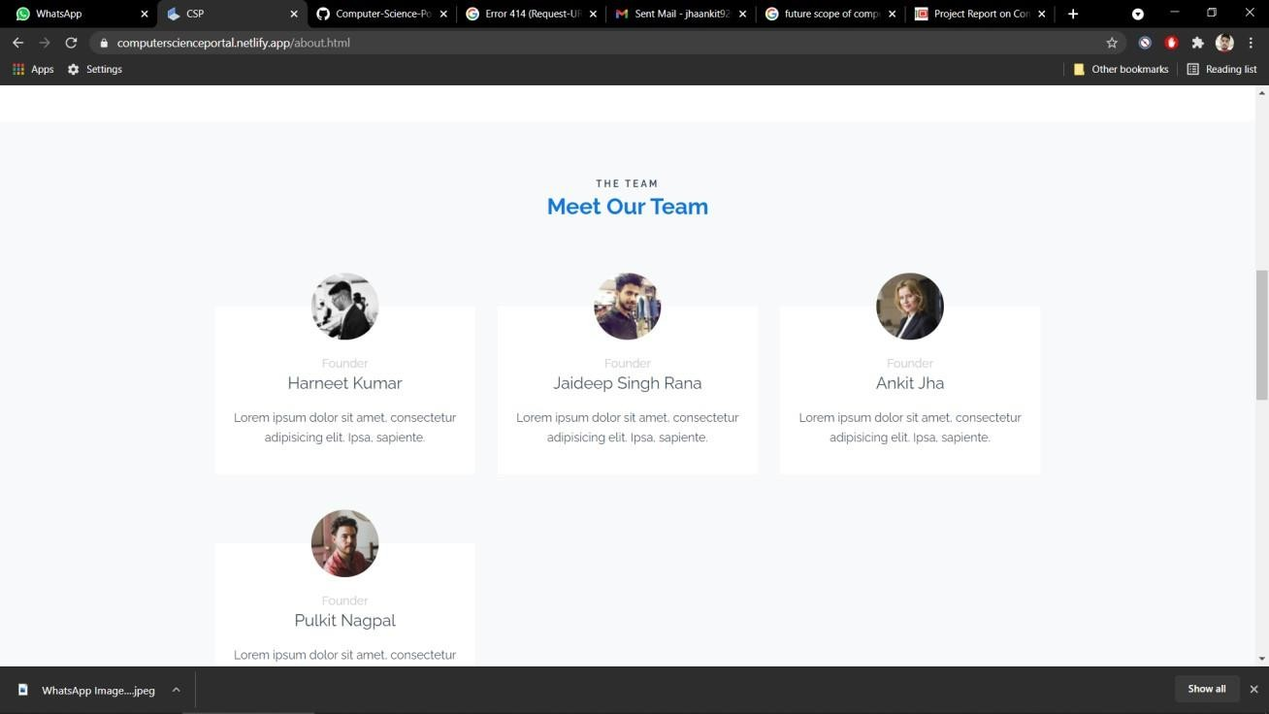

Slide 15



